Slide 1
How to import hrm sql script to MySQL
Huy Nguyen
nqhuy1@tma.com.vn

Slide 2
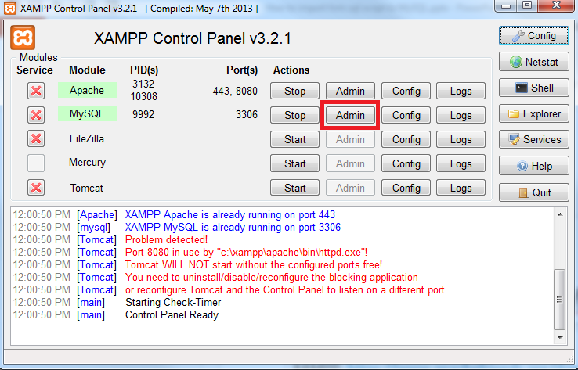
Step 1: install phpMyAdmin
1. Install xampp as following:
XAMPP: https://www.apachefriends.org/download.html
2. Run phpMyadmin:

Slide 3
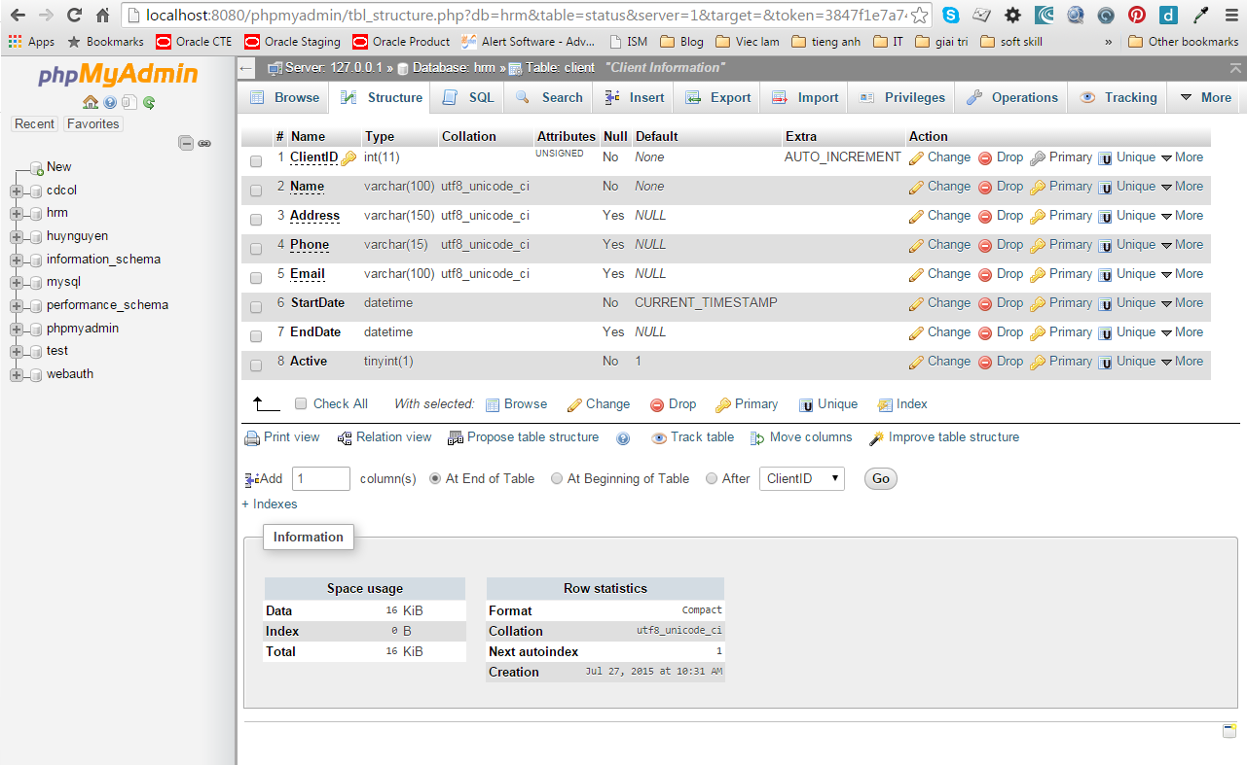
Step 1: install phpMyAdmin
3. phpmyadmin interface

Slide 4
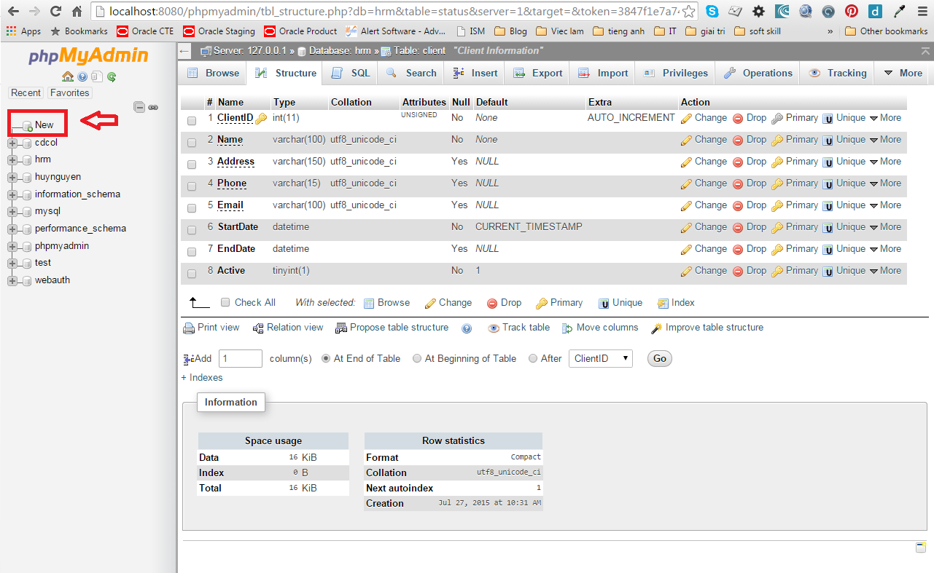
Step 2: Create database “hrm”
1. Click “new”

Slide 5
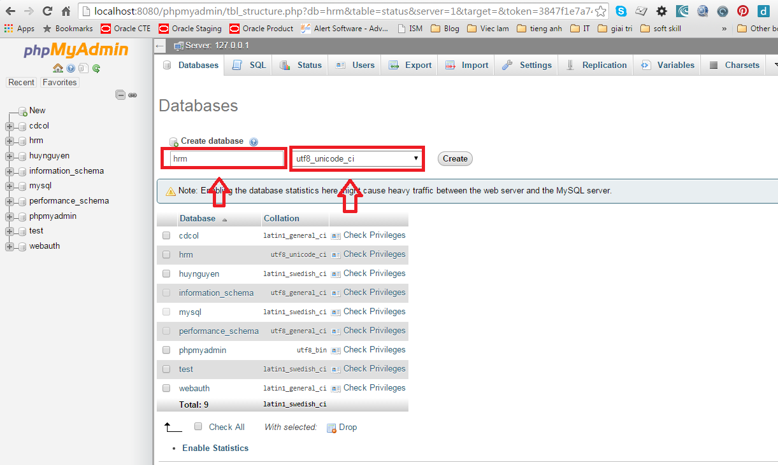
Step 2: Create database “hrm”
2. Database name: hrm
3. Collation: utf8_unicode_ci

Slide 6
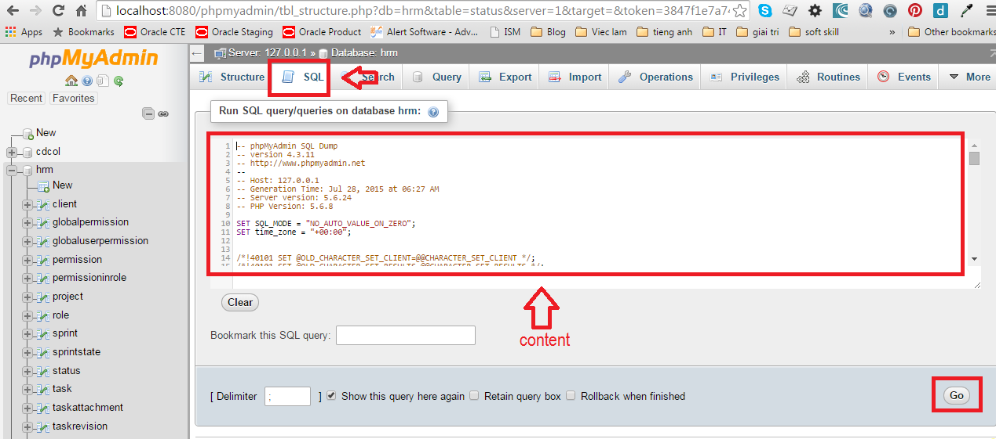
Step 3: Import data to database “hrm”
1. Click “SQL” tab
2. Copy sql content to the field
3. Click “Go” button

